Slide 1
Ethical Hacking Task -2
By Yashika Shetty
(yashika.shetty_19@sakec.ac.in)

Slide 2
Problem Statement or Task:
To test this website and find all possible vulnerabilities and loopholes in it. To do so you can use the automatic vulnerabilities scanner “Netsparker” which was taught to you in the session of Automatic Vulnerability Scanner.
## NOTE : As I was facing error in downloading Netsparker , I used various tools to do reconnaissance and find the vulnerabilities . Some of them are builtwith, virustotal, Wappalyzer , Uniscan, Nikoto and a pen testing website

Slide 3
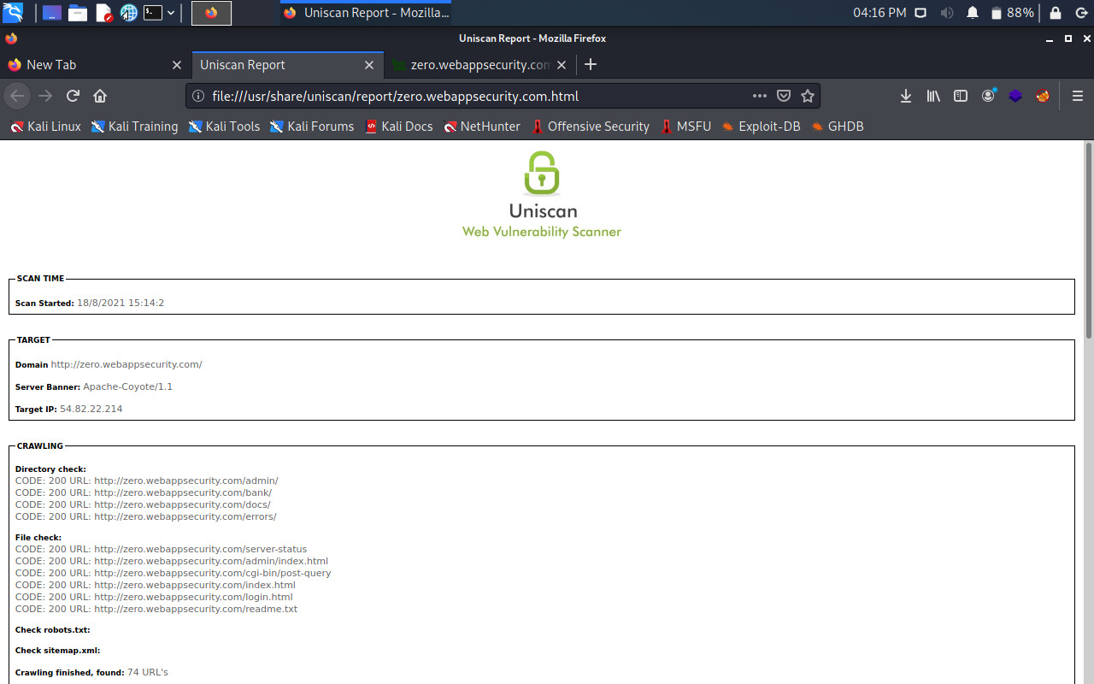
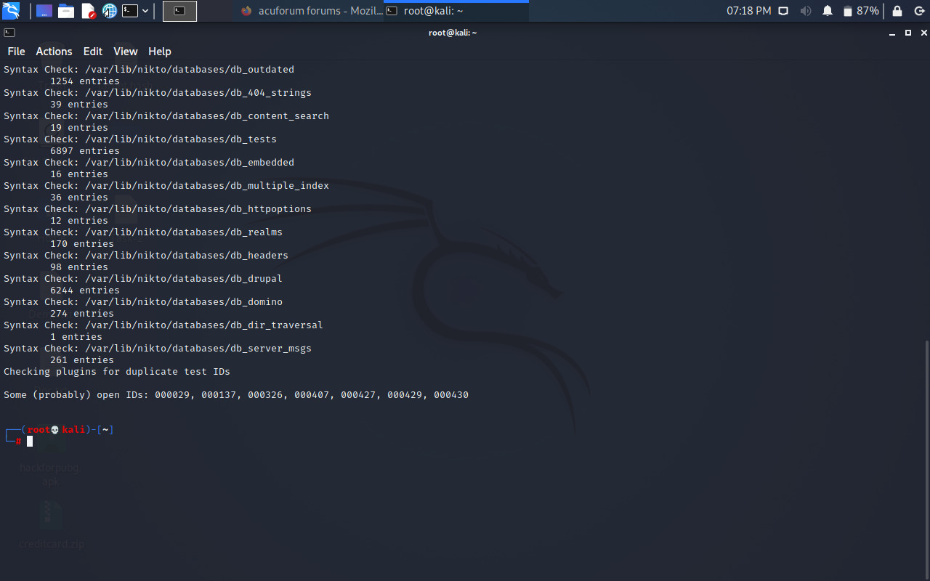
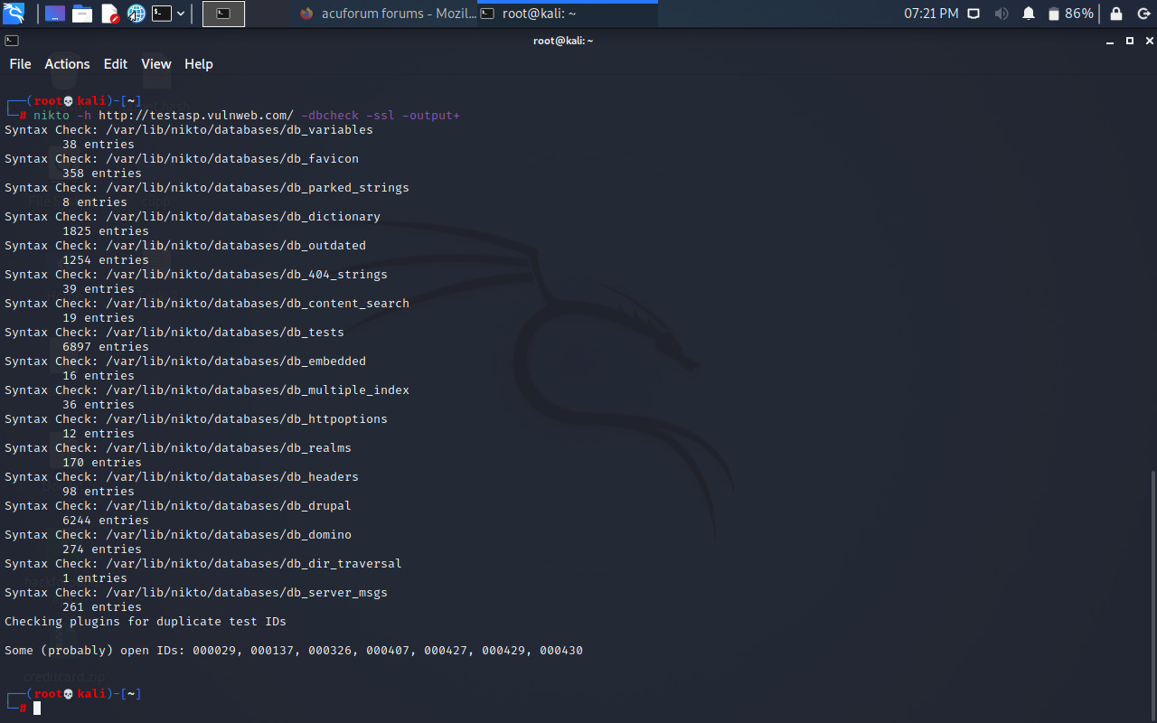
The Findings:

Slide 4
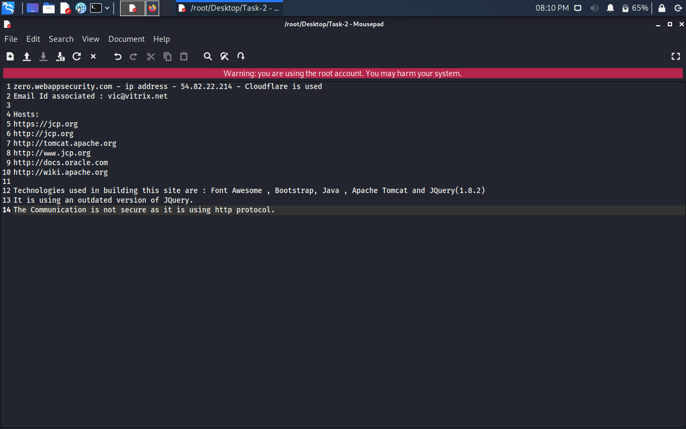
My Report:

